Slide 1


UNIVERSITY INSTITUTE OF ENGINEERING
COMPUTER SCIENCE ENGINEERING
Bachelor of Engineering (Computer Science & Engineering)
Subject Name: STATISTICAL METHODS USING R
Subject Code: 20SMT-460

Slide 2
Averages or Measures of Central Tendency or Measures of Location:

Slide 3
According to Professor Bowley averages are "statistical constants which enable us to comprehend in a· single effort the significance of the whole." They give us an idea about the concentration of the values in the central part of the distribution. Plainly speaking, an average of a statistical series is the value of the variable Which is representative of the entire distribution. The following are the measures of central tendency that are in common use:
(i) Arithmetic Mean or simply Mean,
(ii) Median,
(iii) Mode.

Slide 4
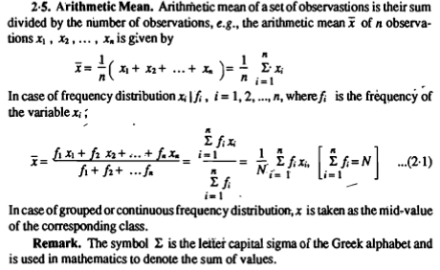

Slide 5
Key Characteristics:
The mean represents the "typical" value in a dataset.
It is sensitive to extreme values (outliers), which can heavily influence the result.
The mean is commonly used in various fields, including statistics, economics, and science.

Slide 6
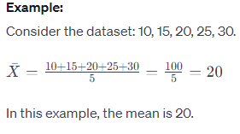

Slide 7
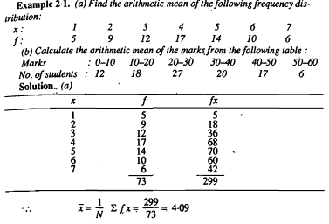

Slide 8
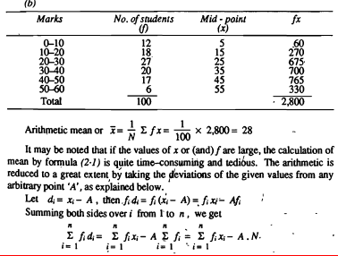

Slide 9
https://www.youtube.com/watch?v=1MiT06JFNo4&pp=ygUvbWVhc3VyZSBvZiBjZW50cmFsIHRlbmRlbmN5IGFuZCBkaXNwZXJzaW9uIGlpdCA%3D

